Slide 1
Latest advancements on the ANN
Maxime Landry

Slide 2
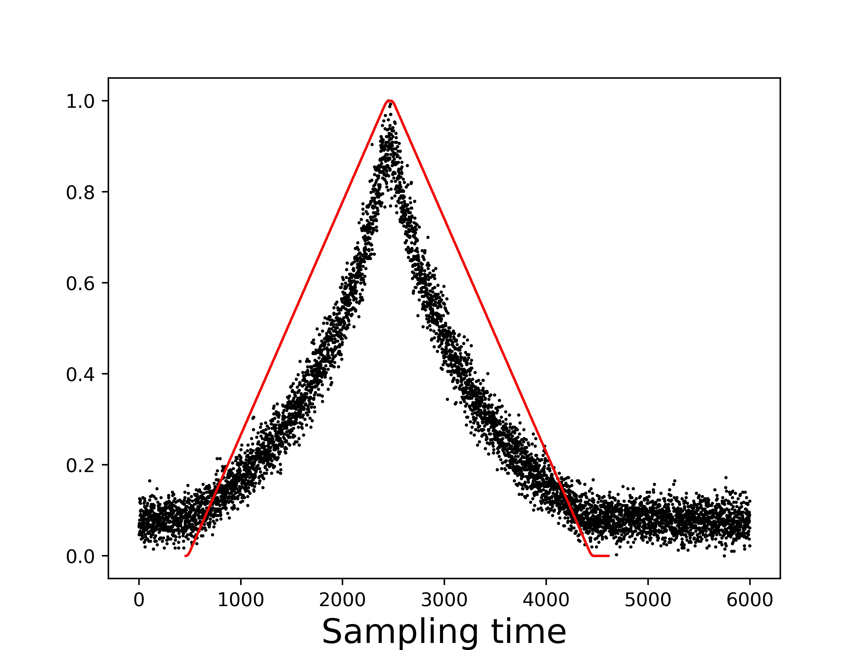
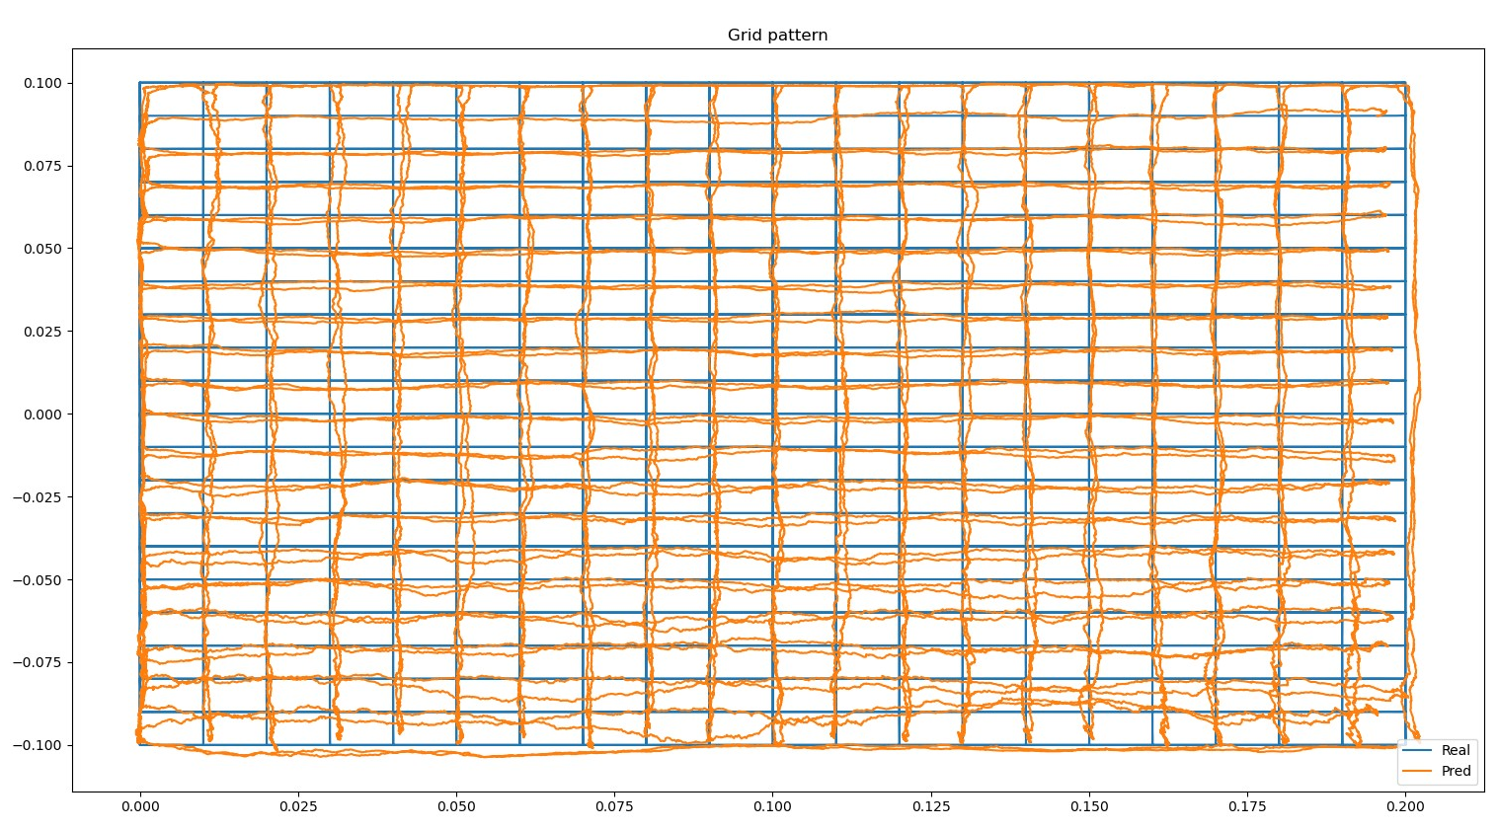
First Grid prediction with a 4.54 s lag
The curves seemed aligned
The grid shown bigger errors in the lower part
The lines didn’t connect at the turnover point
2 possible causes were identified :
Malfunctioning detector
Lag error

Slide 3
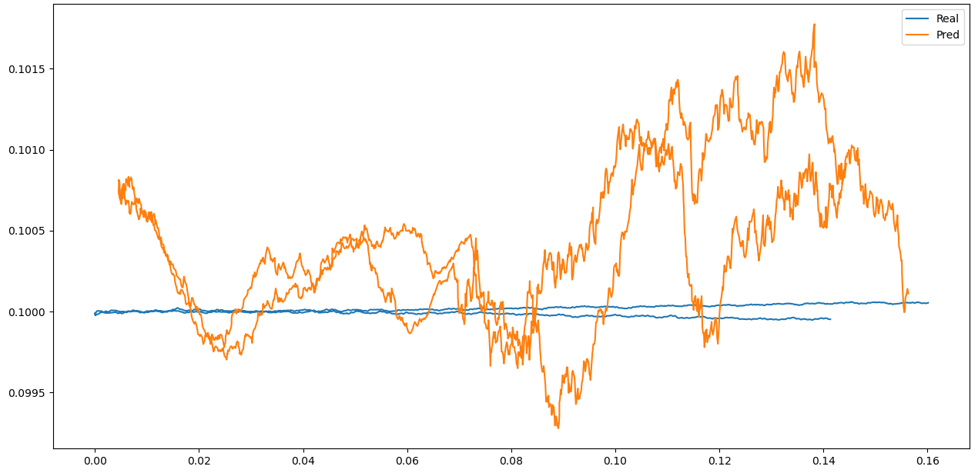
Line prediction with a 4.54 s lag
Line from the upper part of the grid
Minimal error in the y-direction
3-5 mm error in the x-direction

Slide 4
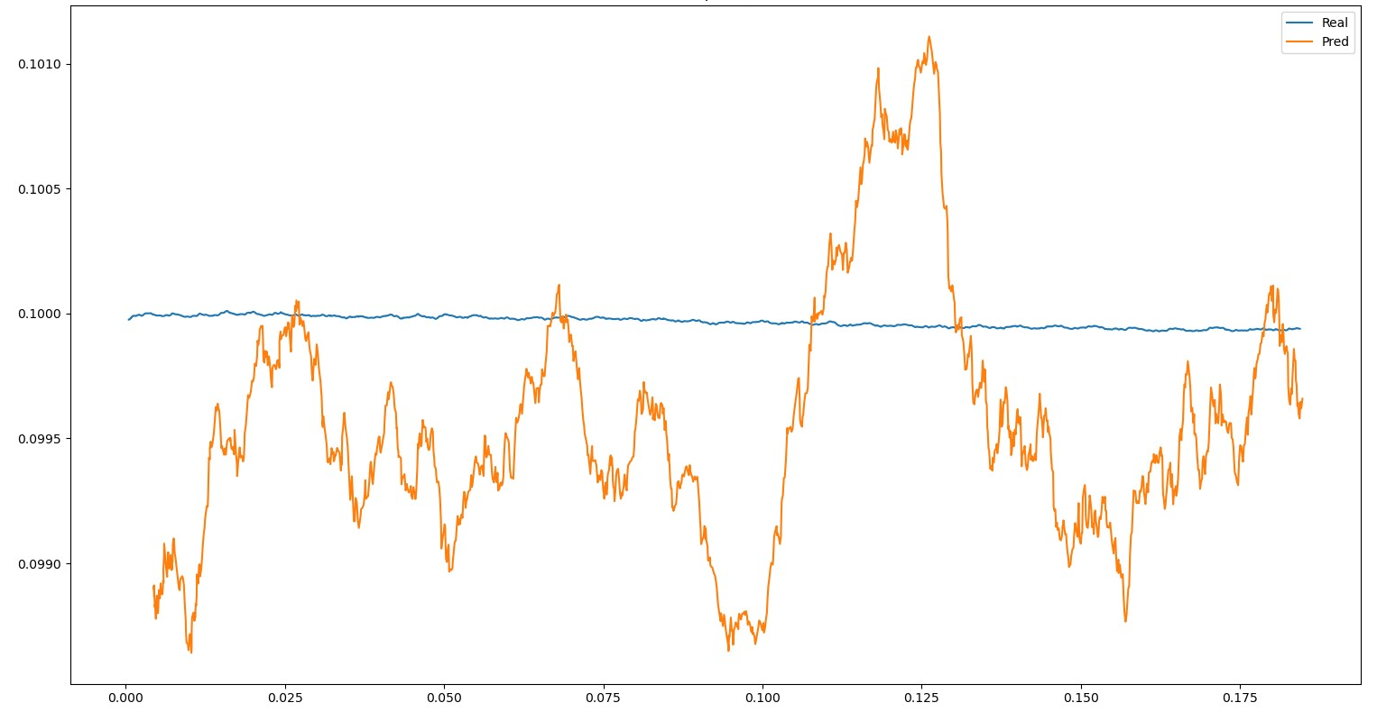
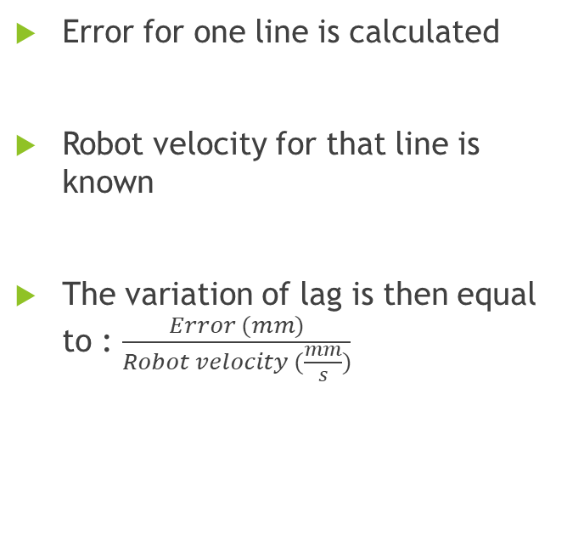
Fixing the lag
Error for one line is calculated
Robot velocity for that line is known
The variation of lag is then equal to : $\frac{Error (mm)}{Robot velocity (\frac{mm}{s})}$

Slide 5
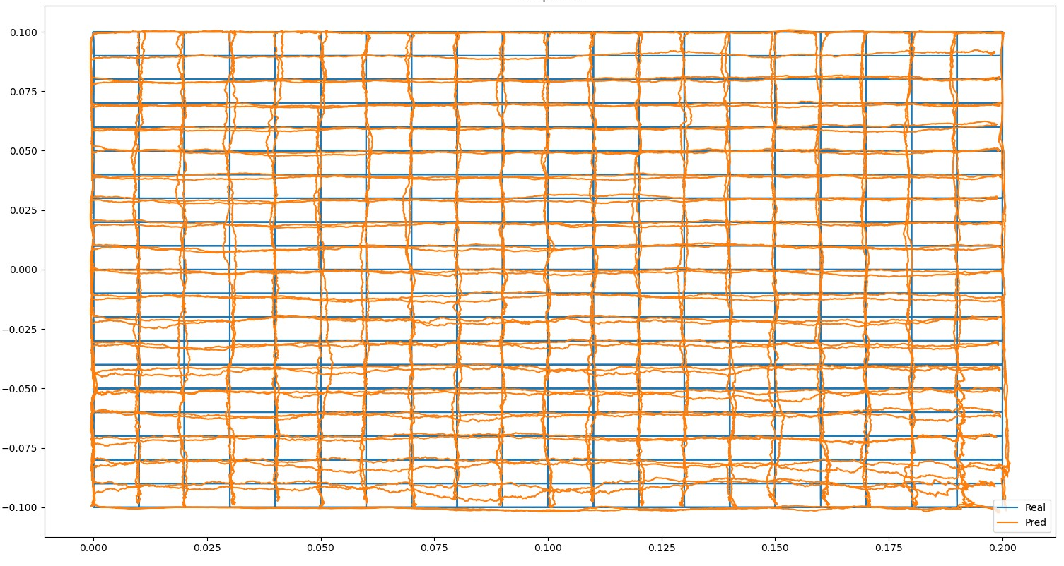
Conclusion on the data set
Upper part is still good
Lower part has some issues in predicting y position
Propable cause : malfunctioning detector in the lower part

Slide 6
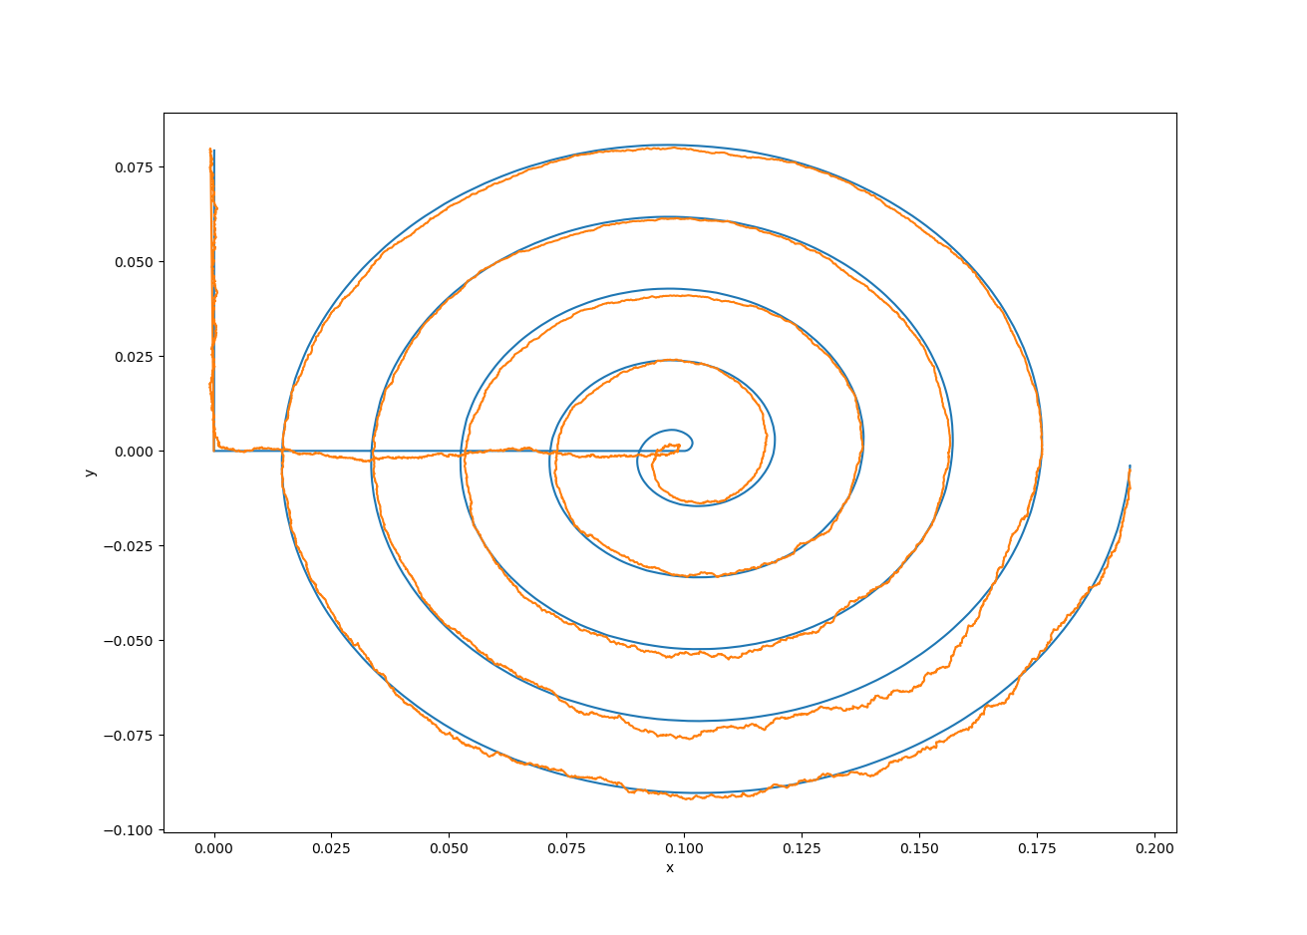
Improving the ANN
Parameters modified :
Epochs
Batch size
Number of layers
Number of neurons/layer
Learning rate
Activation functions
Optimizer
Results at the moment :
Minimum MAE in x : 0.63 mm
Minimum MAE in y : 0.96 mm
Minimum MAEs for the same architecture : 0.66 mm in x and 0.98 mm in y

Slide 7
Things I learned
A mix of different activation function for the hidden layer can reduce the error
Tanh can, in certain case, smoothen the curve, but it’s not always the case
Some architecture become overtrained after 800 epochs while others after 50000+ epochs.
The same architecture can give different results for the same reconstruction

Slide 8
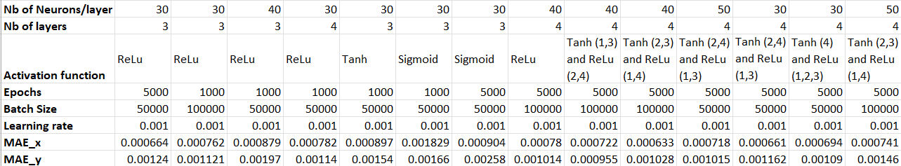
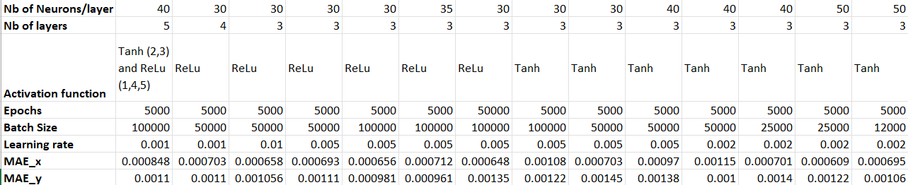
Results from all runs

Slide 9
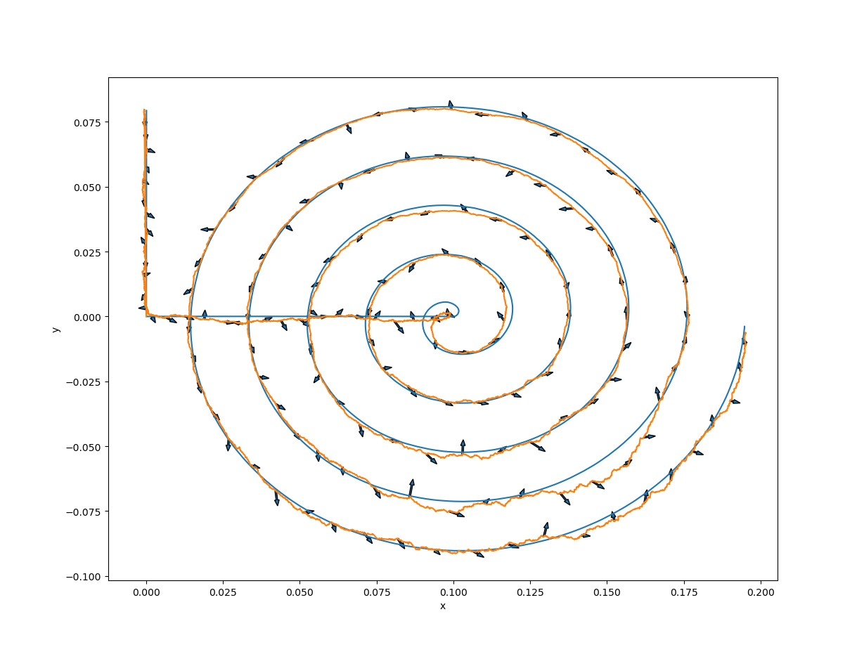
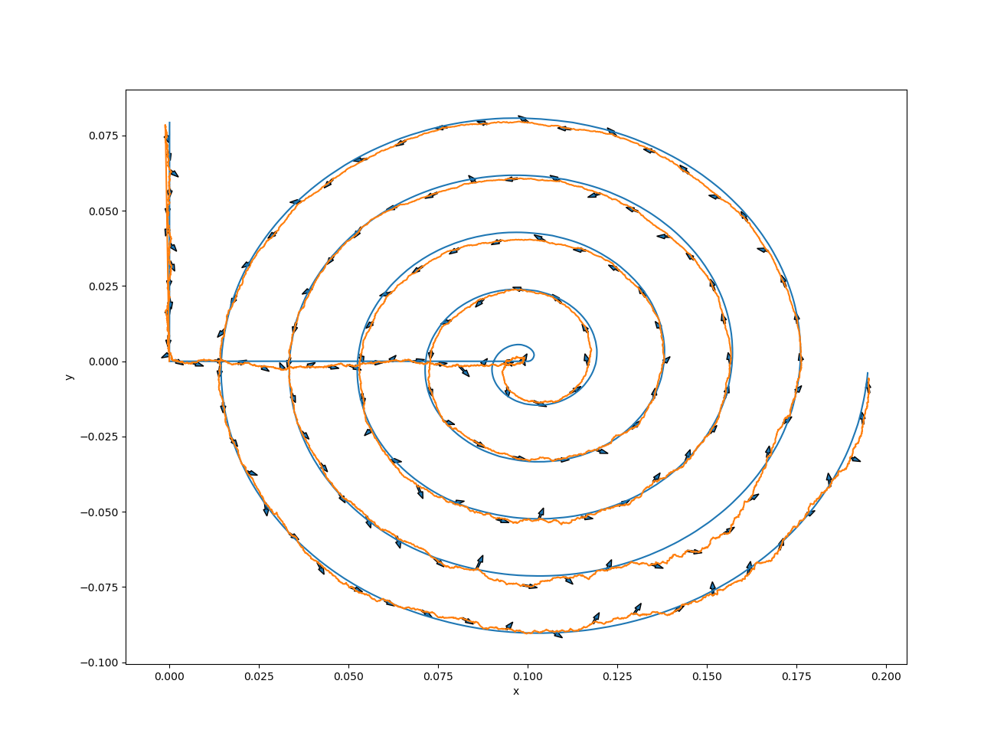
Plan for the next week
3 points
ANN code 2D to 3D
Improve the architecture in 3D (goal in <1 mm error)
Evaluate the velocity with the best method
Prepare the third example during the hackaton
7 points

